Slide 1
CSE408
Asymptotic notations
Lecture #4

Slide 2
Asymptotic Notations
The efficiency analysis framework concentrates on the order of growth of an algorithm’s basic operation count as the principal indicator of the algorithm’s
To compare and rank such orders of growth, computer scientists use three notations:(big oh), (big omega), and (big theta)efficiency

Slide 3
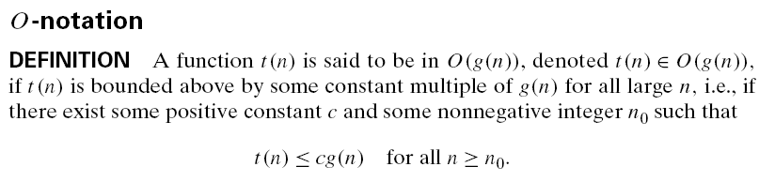
O Notation

Slide 4
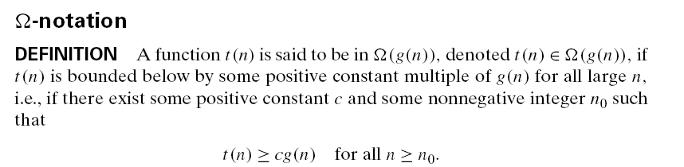
Big omega Notation

Slide 5
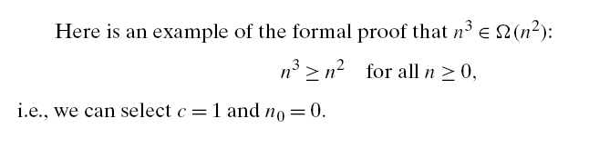
Example

Slide 6
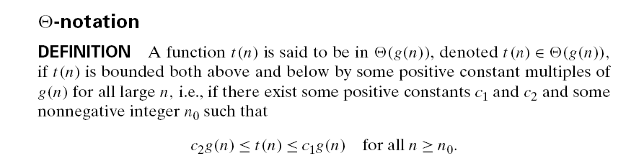
Theta Notation

Slide 7
Asymptotic order of growth
A way of comparing functions that ignores constant factors and small input sizes
O(g(n)): class of functions f(n) that grow no faster than g(n)
Θ(g(n)): class of functions f(n) that grow at same rate as g(n)
Ω(g(n)): class of functions f(n) that grow at least as fast as g(n)

Slide 8
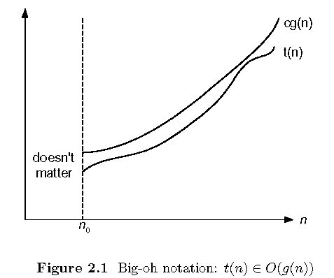
Big-oh

Slide 9
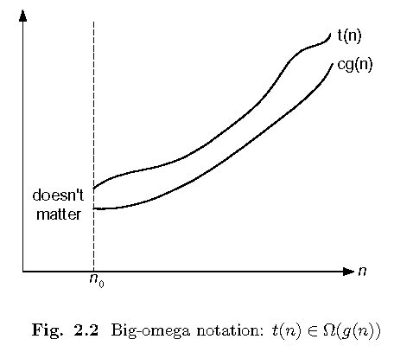
Big-omega

Slide 10
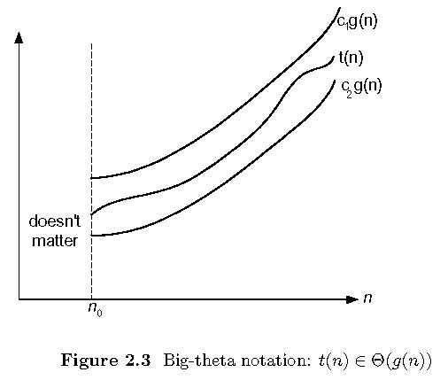
Theta

Slide 11
Some properties of asymptotic order of growth
f(n) ∈ O(f(n))
f(n) ∈ O(g(n)) iff g(n) ∈Ω(f(n))
If f (n) ∈ O(g (n)) and g(n) ∈ O(h(n)) , then f(n) ∈ O(h(n))
Note similarity with a ≤ b
If f₁(n) ∈ O(g₁(n)) and f₂(n) ∈ O(g₂(n)) , then
f₁(n) + f₂(n) ∈ O(max{g₁(n), g₂(n)})

Slide 12
Establishing order of growth using limits
0 order of growth of T(n) < order of growth of g(n)
lim T(n)/g(n) =
c > 0 order of growth of T(n) = order of growth of g(n)
n→∞
∞ order of growth of T(n) > order of growth of g(n)
Examples:
10n vs. n²
n(n+1)/2 vs. n²

Slide 13
L’Hôpital’s rule and Stirling’s formula
L’Hôpital’s rule: If lim_{n→∞} f(n) = lim_{n→∞} g(n) = ∞ and
the derivatives f´, g´ exist, then
Stirling’s formula: n! ≈ (2πn)^{1/2} (n/e)^{n}
f(n)
g(n)
f ´(n)
g ´(n)
lim
n→∞
=
lim
n→∞
Example: log n vs. n
Example: 2^{n} vs. n!

Slide 14
Exmaple

Slide 15
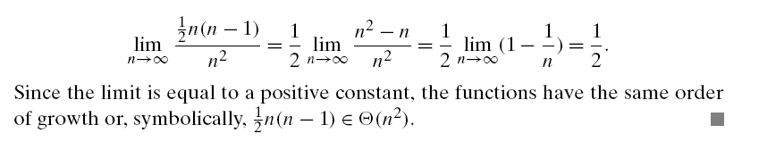
Example

Slide 16
Example

Slide 17
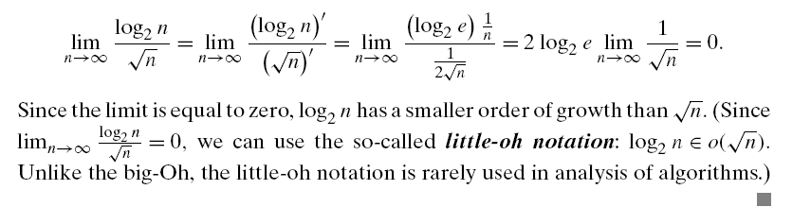
Example

Slide 18
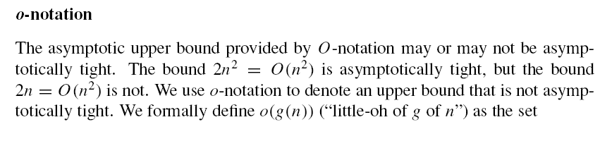
Small Oh Notation

Slide 19
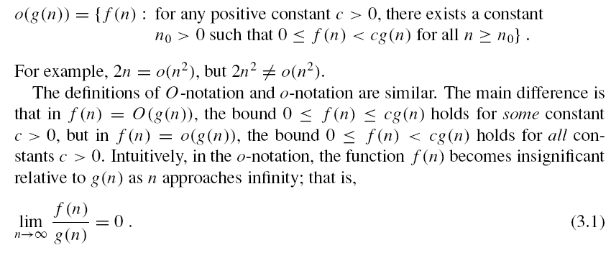
Small Oh Notation

Slide 20
Exmaple

Slide 21
Orders of growth of some important functions
All logarithmic functions log_{a} n belong to the same class
Θ(log n) no matter what the logarithm’s base a > 1 is
All polynomials of the same degree k belong to the same class: a_{k}n^{k} + a_{k-1}n^{k-1} + … + a₀ ∈ Θ(n^{k})
Exponential functions a^{n} have different orders of growth for different a’s
order log n < order n^{α} (α>0) < order a^{n} < order n! < order n^{n}

Slide 22
Basic asymptotic efficiency classes
1 | constant
log n | logarithmic
n | linear
n log n | n-log-n
n² | quadratic
n³ | cubic
2^{n} | exponential
n! | factorial

Slide 23
Thank You !!!

